Slide 1

2 Tablets

Slide 2
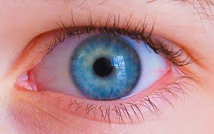
Direct Evidence

Slide 3
Direct evidence
Self experience.
Eye problems.
Perception change in seeing.
Sarvendriyanam nayanam pradaanam !
Crystal clear, third eye ,vision/astral travel/past life exp/day to day material exp - facing it.
Deed and feeling stages of four levels of perfection (Deed means coming out of likes & dislikes)

Slide 4

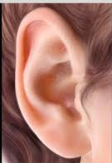
Indirect Evidence

Slide 5

INDRECT EVIDENCE:
> Knowledge got through other people/thing.
>Attributed to ear problems.
>By means of SWADHYAYA,ACHARYA SANGATYA etc,.
>Selected people – constant learning.
Speech & writing phases of four levels of perfection.

Slide 6


DYNAMIC

Slide 7
DYNAMIC:
> Able to Change the things immediately/when found - less evolution
>Tribal x scientist – story
>Thyroid problems

Slide 8

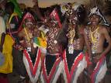
STATIC

Slide 9
STATIC
>Understanding/quality unchanged-need not be changed at all
>Ahimsaparamohdharmaha etc.,
>Unconscious evolution / static to dynamic.
>Inter exchange is a time bound process(over a period of time)

Slide 10

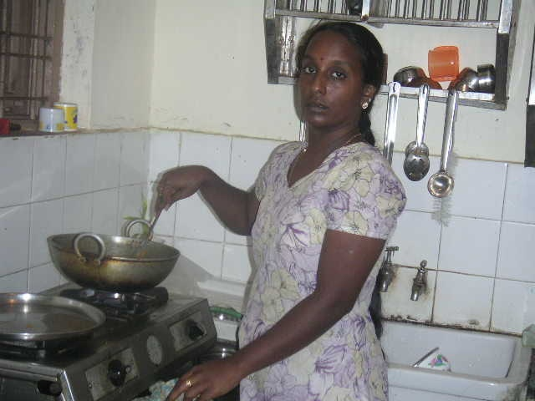
COMMONSENSE

Slide 11
COMMONSENSE
Some total of all levels of souls.
Basic common sense.
Material plane people.
Spiritual masters - Drama

Slide 12

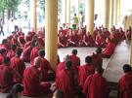
EXPERIENCE

Slide 13
EXPERIENCE
Experience – Spiritual experience
Metaphysical( Prediction etc.,) other dimension experiences.
Sheer common sense.
Accountant phase only - Experience.

Slide 14


WARRIOR

Slide 15
WARRIOR:
Heights of intention.
Determined for seeking truth.
Total surrenderness.
Empty cup.

Slide 16


NON WARRIOR

Slide 17
NON WARRIOR:
Non – determined.
Time Pass.
Only to particular target ( Health, money..).
In likes and dislikes.

Slide 18


ALCOHOLIC

Slide 19
ALCOHOLIC
That’s the only work (“Mad” about).
Renounce.
Addiction.
Major mistake.
Sudden transformation.

Slide 20


HOLISTIC

Slide 21
HOLISTIC
Equal time slots.
Considering every thing.
Proper Planning.
Open / Frank.

Slide 22


MAJOR MISTAKE

Slide 23
MAJOR MISTAKE
50-50 concept( past and present ).
All actions “ Gross Level”.
Chosen work itself wrong.
Purpose of life(Different in different life times).
Job, place of living, marriage and spiritual path etc,.

Slide 24


MINOR MISTAKE

Slide 25
MINOR MISTAKE
Quality of speech, writing, Arts.
Fine work.
Has an alternative.
Kidney and ureter problems.
Identification – expulsion
Thought – Speech – Place – Time – Money.
Daily introspection.

Slide 26

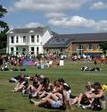
DAY

Slide 27
DAY
Community god
All Spiritual services
Material happiness
Laxmi & Sarasvathi.
Attained mastery – exceptional silence.

Slide 28

NIGHT

Slide 29
NIGHT
Self learning
All spiritual practices
Swadharma
Parvathi
New age – online job.

Slide 30

ON THE SCREEN

Slide 31
ON THE SCREEN
Common truth – for all sects of wisdom(people).
Everywhere
On stage – no privacy issue.
Community growth.
“No lie” – Phase.

Slide 32
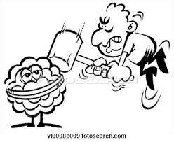
BEHIND THE SCREEN

Slide 33
behind the screen
Particular person , particular time..place etc,.
Not for whole group – individual growth(Mostly).
Exceptional cases.
No right and wrong – situational lie exists.
Can’t digest ! – check whether you are in right position.
Back door entry (Home) – Dreams or situations.

Slide 34


GOOD

Slide 35
GOOD
Result of new learning
Moral’s X Spiritual laws
What you give, that you will get.

Slide 36
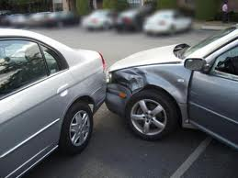
BAD

Slide 37
BAD
Result of static phase / Non learning.
The mark of your ignorance is the depth your belief in injustice and tragedy.
Every thing is by choice.
Small problem to avoid a big one.

Slide 38


LUCK

Slide 39
LUCK
A LOTTORY TICKET.
Adrustam.
A + Druistam = unseen.
Unseen - favorable / unfavorable.
Unseen for physical eyes.

Slide 40

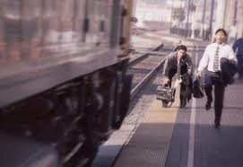
BAD LUCK

Slide 41
BAD LUCK
Material people - invented word.
Unfavorable unseen.
Unseen to physical eyes.
Completed third eye – no bad luck – deserved / undeserved.
Spiritual master – no suffering.

Slide 42


SUPPORTED

Slide 43
SUPPORTED
Able to do on his own.
Supported environment.
Good past balance.
Below 40% deviation from purpose.
Physically, mentally fit for basic guidelines.

Slide 44

NON SUPPORTED

Slide 45
NON SUPPORTED
No one supports your path(Family restrictions).
Material & Spiritual Situation.
More than 40% deviation form purpose.
Physically, mentally not fit for basic guidelines.
Bedridden, executive job, new area, child baring etc,..
Individuality important.
5 to 10 mins per day – daily.

Slide 46
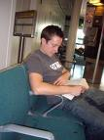
WAKE FUL

Slide 47
WAKE FUL
Pleasures - Physical senses.
oneness god.
Earth dimension.
Purposeful actions.
Optimal diet.
Creative visualization.
Living in the moment.

Slide 48


SLEEP

Slide 49
SLEEP :
Voluntary induced hypnotic regression state.
Dimensions other than earth – Energy and Wisdom.
Dreams - swadharma.
Past / Future progression.
1hr meditation = 6hrs Sleep.
Major sleep – Minor sleep – In a day.
Its an astral projection rather than physical rest.

Slide 50

THANK YOU

